Slide 1
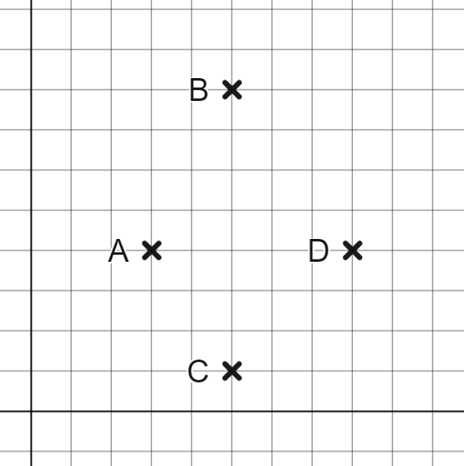
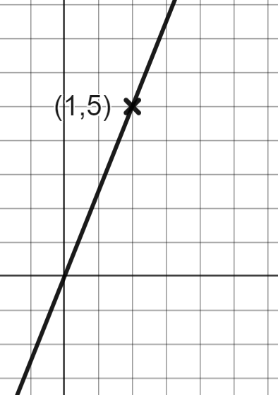
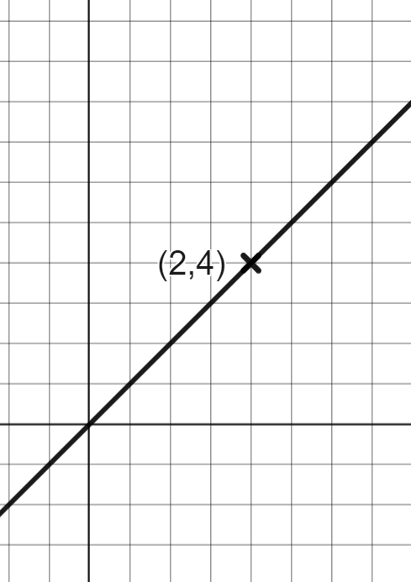
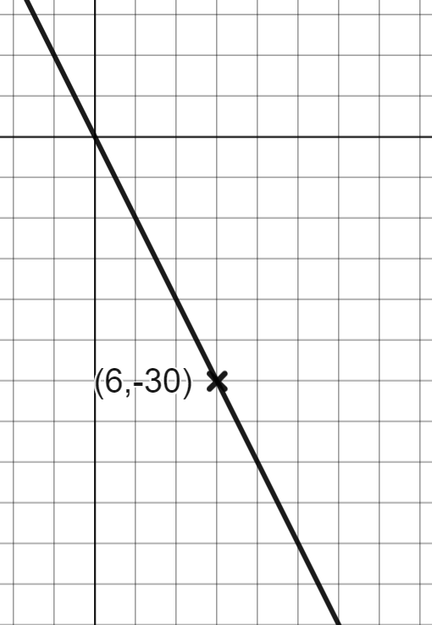
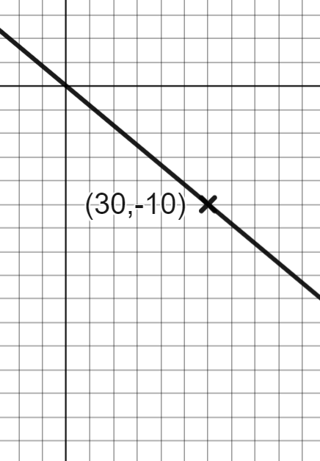

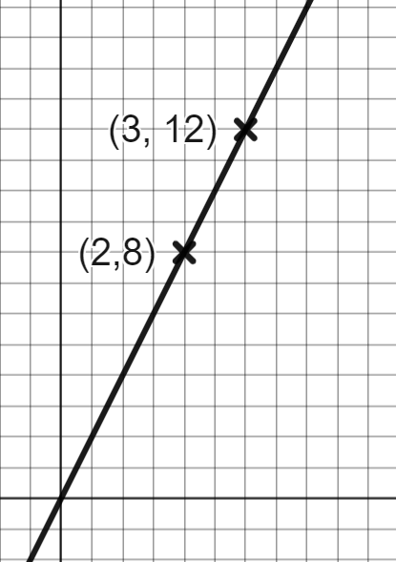
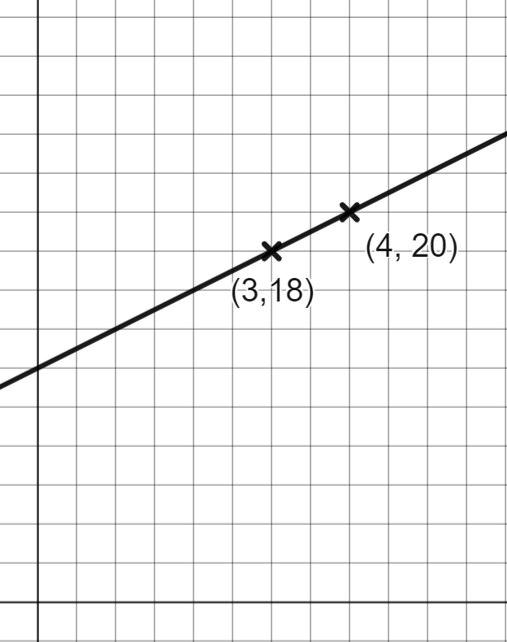
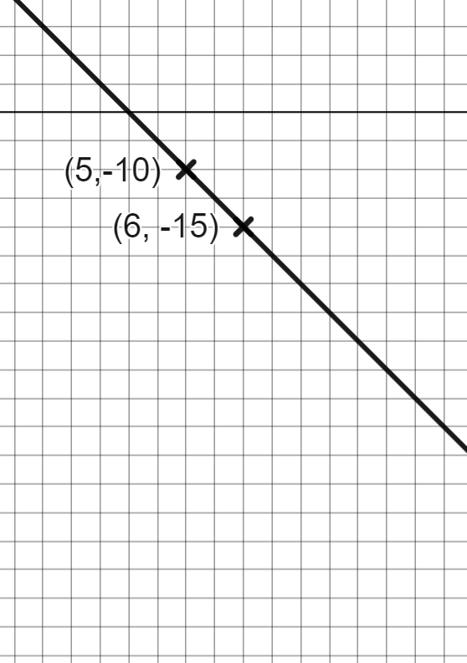
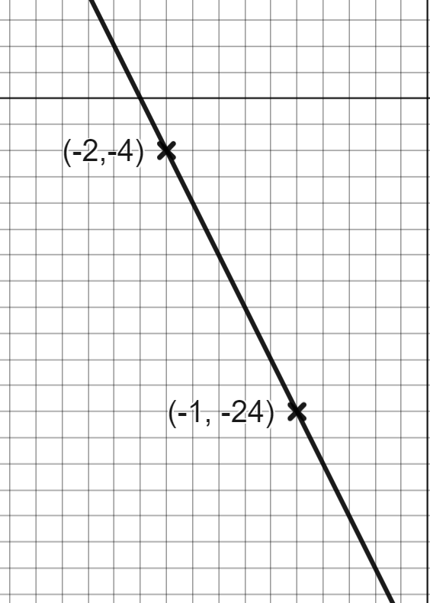
Rate of change from a coordinate pair
Task A: Reading the axes accurately to calculate gradient
1) The points A, B, C and D have been plotted on the same axes.
Which is steeper
A to B or C to D?
A to C or B to D?
A to B or A to C?
Where could you move the coordinate, D, to make this shape a parallelogram?
A to B
A to C
A to B
D
×
One square left and one square up.
2) Calculate the gradient of each line.
5
2
−5
4
2
−5
−20

Slide 2
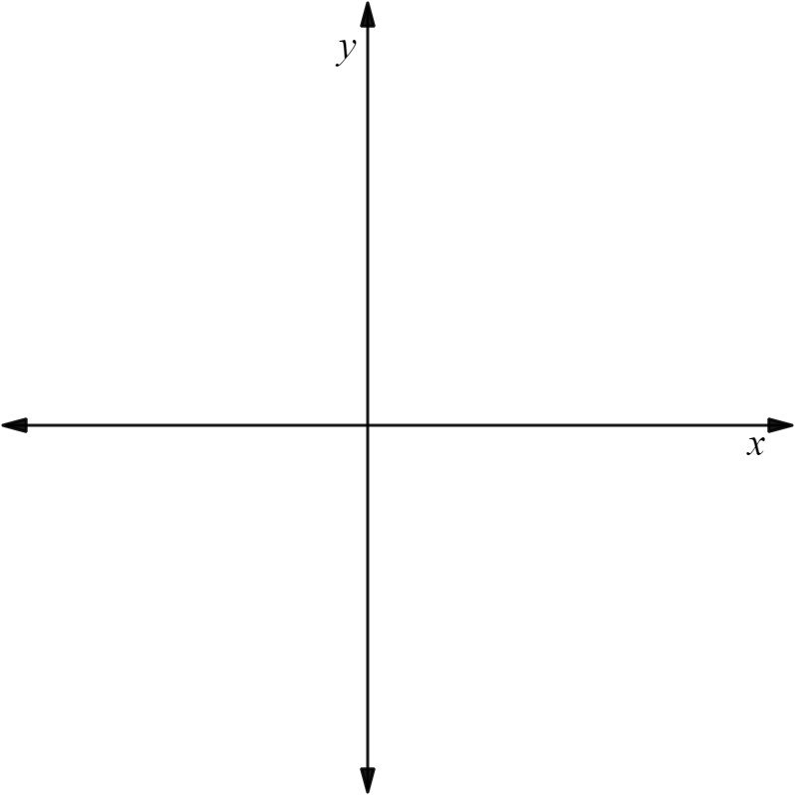

Rate of change from a coordinate pair
Task B: Calculating gradient from coordinate pairs
1) Find the gradient of the line joining the 2 coordinates given. You may use the axis to help
a) (7,8) and (4,2) | b) (−1,8) and (1,2) | c) (−1,−2) and (1,10) | d) (3,−2) and (−5,10)
×
×
+2
×
×
+8
+6
−6
+12
−12
×
×
+3
×
×
+2
3 | 6
1 | 2
2 | −6
1 | −3
2 | 12
1 | 6
8 | −12
1
gradient = 2
gradient = −3
gradient = 6
2) In each question, decide which line will be steeper
a) The line joining (0,0) and (5,7) or the line joining (0,0) and (5,−4)
b) The line joining (0,0) and (3,4) or the line joining (0,0) and (6,7)
c) The line joining (1,2) and (2,5) or the line joining (5,1) and (6,5)
d) The line joining (−4,4) and (5,−4) or the line joining (2,−1) and (11, −8)
Larger change in y for the same change in x.
For the same gradient the second coordinate would need to be (6,8).
Larger change in y for the same change in x.
Larger change in y for the same change in x.

Slide 3
Rate of change from a coordinate pair
Task C: Coordinates that lie on a straight line
1) By testing the gradient. See whether each set of 3 points lie on a straight line.
(1,2), (2,6) and (4,12)
(2,−8), (6,−4) and (13,3)
(0,9), (2,5) and (5,−1)
(−5, 0), (−3,−4) and (3,−8)
No, the gradient between (1,2) and (2,6) is 4 but the gradient between (2,6) and (4,12) is 3
Yes, the gradient between any 2 points is 1
Yes, the gradient between any 2 points is −2
No, the gradient between (−5, 0) and (−3,−4) is −2 but the gradient between (−5, 0) and (3, −8) is −1
Mathematics in Education and Industry
v2.2

